Slide 1
Natural Language Processing
Sentiment Analysis

Slide 2
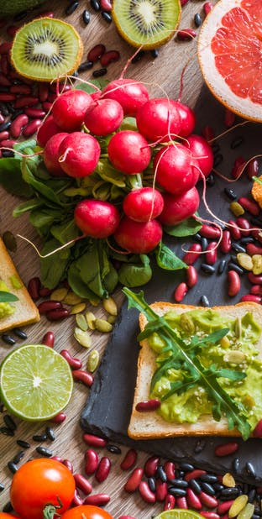
Every one should go vegan
Fact or opinion
Positive or Negative
Argument or no argument
Because vegan diets are healthier than eating meat

Slide 3
Many times what we say is not merely an objective fact
Instead, it often expresses our attitudes or opinions toward some topic
What attitude/opinion? — Sentiment Analysis
Why that attitude/opinion? — Argumentation

Slide 4
What is Sentiment Analysis
Sentiment analysis (also known as opinion mining or emotion AI) refers to
the use of natural language processing, text analysis, computational linguistics, and biometrics
to systematically identify, extract, quantify, and study
affective states and
subjective information.

Slide 5
Affective States
Emotion: Brief and intense episode of organic response to the evaluation of an event (angry, sad, joyful, fearful, ashamed, proud)
Mood: Enduring and less intensive predominance of subjective feelings, often without apparent cause (cheerful, gloomy, irritable, depressed)
Interpersonal stance: Affective stance occurring in the interaction with another person, coloring the interpersonal exchange of that situation (polite, distant, cold, warm, supportive)
Attitudes: Enduring beliefs and predispositions towards specific objects or persons (like, hate, value, desire)
Personality traits (affect disposition): Stable personality dispositions and behavior tendencies (nervous, anxious, reckless, morose, hostile, envious, jealous)

Slide 6
Subjective Information
Judgment/Evaluation: determination of the value, nature, character, or quality of something or someone (this movie is garbage / unfortunately the battery lasts less than 5 minutes)
Personal belief (I don't think the earth is round)
Not the main focus of many sentiment analysis systems
But argumentation systems care!

Slide 7
Sentiment Analysis
Sentiment analysis is the detection of attitudes
“enduring, affectively colored beliefs, dispositions towards objects or persons”
Holder (source) of attitude
Target (aspect) of attitude
Type of attitude
From a set of types
Like, love, hate, value, desire, etc.
Or (more commonly) simple weighted polarity:
positive, negative, neutral, together with strength
Text containing the attitude
Sentence or entire document

Slide 8
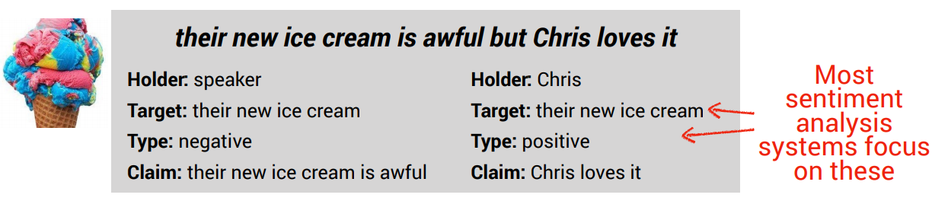
Structure of Sentiment Information
Holder: Experiencer of the affective state or opinion (usually the speaker if not stated otherwise)
Target: Target of the affective state or opinion
Type: Type of the affective state or opinion (often simplified as positive/negative/neutral)
Claim: Text that contains the affective state or opinion

Slide 9
Sentiment Analysis
Simplest task:
Is the attitude of this text positive or negative?
More complex:
Rank the attitude of this text from 1 to 5
Advanced:
Detect the target, source, or complex attitude types

Slide 10
Sentiment Analysis
Simplest task:
Is the attitude of this text positive or negative?
More complex:
Rank the attitude of this text from 1 to 5
Advanced:
Detect the target, source, or complex attitude types

Slide 11
Why sentiment analysis?
Movie: is this review positive or negative?
Products: what do people think about the new iPhone?
Public sentiment: how is consumer confidence? Is despair increasing?
Politics: what do people think about this candidate or issue?
Prediction: predict election outcomes or market trends from sentiment

Slide 12
How to do sentiment analysis
Lexicon based Approaches
Machine Learning Based Approaches

Slide 13
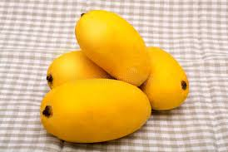
Chaunsa the King of Mangoes is soft, is almost fiberless, and has an aromatic, pleasant, sweet flavor.

Slide 14
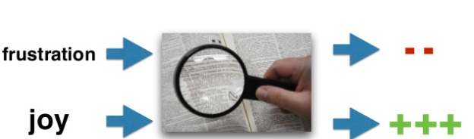
Lexicon Approach
Rely on external lexical resources that associate a polarity score to each term.
Sentiment of the content depends on the sentiment of the terms which compose it.

Slide 15
The General Inquirer
Home page: http://www.wjh.harvard.edu/~inquirer
List of Categories: http://www.wjh.harvard.edu/~inquirer/homecat.htm
Spreadsheet: http://www.wjh.harvard.edu/~inquirer/inquirerbasic.xls
Categories:
Positiv (1915 words) and Negativ (2291 words)
Strong vs Weak, Active vs Passive, Overstated versus Understated
Pleasure, Pain, Virtue, Vice, Motivation, Cognitive Orientation, etc
Free for Research Use

Slide 16
LIWC (Linguistic Inquiry and Word Count)
Home page: http://www.liwc.net/
2300 words, >70 classes
Affective Processes
negative emotion (bad, weird, hate, problem, tough)
positive emotion (love, nice, sweet)
Cognitive Processes
Tentative (maybe, perhaps, guess), Inhibition (block, constraint)
Pronouns, Negation (no, never), Quantifiers (few, many)
$30 or $90 fee

Slide 17
MPQA Subjectivity Cues Lexicon
Home page: http://www.cs.pitt.edu/mpqa/subj_lexicon.html
6885 words from 8221 lemmas
2718 positive
4912 negative
Each word annotated for intensity (strong, weak)
GNU GPL

Slide 18
Bing Liu Opinion Lexicon
Bing Liu's Page on Opinion Mining
http://www.cs.uic.edu/~liub/FBS/opinion-lexicon-English.rar
6786 words
2006 positive
4783 negative

Slide 19
SentiWordNet
Home page: http://sentiwordnet.isti.cnr.it/
All WordNet synsets automatically annotated for degrees of positivity, negativity, and neutrality/objectiveness
[estimable(J,3)] “may be computed or estimated”
Pos 0 Neg 0 Obj 1
[estimable(J,1)] “deserving of respect or high regard”
Pos .75 Neg 0 Obj .25

Slide 20
Disagreements between polarity lexicons
 | Opinion Lexicon | General Inquirer | SentiWordNet | LIWC
MPQA | 33/5402 (0.6%) | 49/2867 (2%) | 1127/4214 (27%) | 12/363 (3%)
Opinion Lexicon |  | 32/2411 (1%) | 1004/3994 (25%) | 9/403 (2%)
General Inquirer |  |  | 520/2306 (23%) | 1/204 (0.5%)
SentiWordNet |  |  |  | 174/694 (25%)
LIWC
Notes:
This sentiment information is only tendency! Actual sentiment of a word is context-dependent!

Slide 21
Target-Specific Lexicon
Restaurant Reviews
Speaker Reviews
My dish was served hot
The food is generally cheap
The music was so loud that we couldn't really talk
It gets hot very easily
The company uses cheap materials
The speaker is very loud
Building target-specific lexicons manually is
very time-consuming and expensive

Slide 22
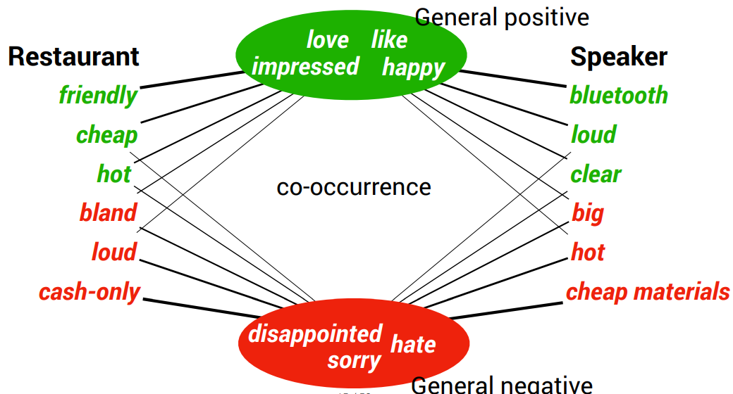
Target-Specific Lexicon

Slide 23
Turney Algorithm
Extract a phrasal lexicon from reviews
Learn polarity of each phrase
Rate a review by the average polarity of its phrases

Slide 24
Extract two-word phrases with adjectives
First Word | Second Word | Third Word (not extracted)
JJ | NN or NNS | anything
RB, RBR, RBS | JJ | Not NN nor NNS
JJ | JJ | Not NN or NNS
NN or NNS | JJ | Nor NN nor NNS
RB, RBR, or RBS | VB, VBD, VBN, VBG | anything

Slide 25
How to measure polarity of a phrase?
Positive phrases co-occur more with “excellent”
Negative phrases co-occur more with “poor”
But how to measure co-occurrence?

Slide 26
Pointwise Mutual Information
Mutual information between 2 random variables X and Y
Pointwise mutual information:
How much more do events x and y co-occur than if they were independent?

Slide 27
Pointwise Mutual Information
Pointwise mutual information:
How much more do events x and y co-occur than if they were independent?
PMI between two words:
How much more do two words co-occur than if they were independent?

Slide 28
Semi-supervised learning of lexicons
Use a small amount of information
A few labeled examples
A few hand-built patterns
To bootstrap a lexicon

Slide 29
Hatzivassiloglou and McKeown intuition for identifying word polarity
Adjectives conjoined by “and” have same polarity
Fair and legitimate, corrupt and brutal
*fair and brutal, *corrupt and legitimate
Adjectives conjoined by “but” do not
fair but brutal

Slide 30
Hatzivassiloglou & McKeown 1997 Step 1
Label seed set of 1336 adjectives (all >20 in 21 million word WSJ corpus)
657 positive
adequate central clever famous intelligent remarkable reputed sensitive slender thriving…
679 negative
contagious drunken ignorant lanky listless primitive strident troublesome unresolved unsuspecting…

Slide 31
Hatzivassiloglou & McKeown 1997 Step 2
Expand seed set to conjoined adjectives
nice, helpful
nice, classy

Slide 32
Hatzivassiloglou & McKeown 1997 Step 3
Supervised classifier assigns “polarity similarity” to each word pair, resulting in graph:
brutal
helpful
corrupt
irrational
nice
fair
classy

Slide 33
Hatzivassiloglou & McKeown 1997 Step 4
Clustering for partitioning the graph into two
+
-
brutal
helpful
corrupt
irrational
nice
fair
classy

Slide 34
Output polarity lexicon
Positive
bold decisive disturbing generous good honest important large mature patient peaceful positive proud sound stimulating straightforward strange talented vigorous witty…
Negative
ambiguous cautious cynical evasive harmful hypocritical inefficient insecure irrational irresponsible minor outspoken pleasant reckless risky selfish tedious unsupported vulnerable wasteful…

Slide 35
Output polarity lexicon
Positive
bold decisive disturbing generous good honest important large mature patient peaceful positive proud sound stimulating straightforward strange talented vigorous witty…
Negative
ambiguous cautious cynical evasive harmful hypocritical inefficient insecure irrational irresponsible minor outspoken pleasant reckless risky selfish tedious unsupported vulnerable wasteful…

Slide 36
Expanding a lexicon
Synonyms and antonyms (from thesaurus, WordNet)
fast = expeditious, rapid, quick, speedy
calm ↔ agitated, angry, inclement

Slide 37
Machine Learning Approach
How to do sentiment analysis

Slide 38
Baseline Algorithm
Tokenization
Feature Extraction
Classification using different classifiers
Naïve Bayes
MaxEnt
SVM

Slide 39
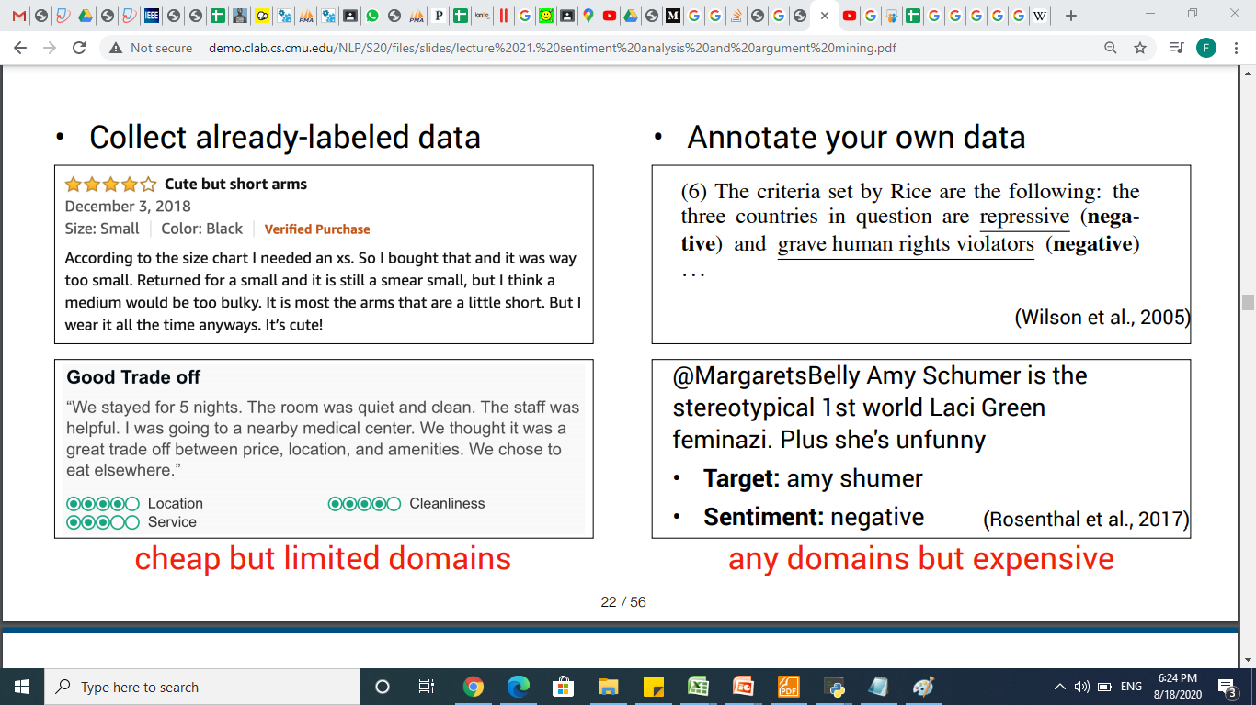
Data

Slide 40
Reminder: Naïve Bayes

Slide 41
Sentiment Analysis Example

Slide 42
No unknown words model, if testing document word is not present in training ignore it.
Features: Predictable, no, fun

Slide 45
Sentiment Tokenization Issues
Deal with HTML and XML markup
Twitter mark-up (names, hash tags)
Capitalization (preserve for
words in all caps)
Phone numbers, dates
Emoticons
Useful code:
Christopher Potts sentiment tokenizer
Brendan O’Connor twitter tokenizer
Potts emoticons
[<>]? # optional hat/brow
[:;=8] # eyes
[\-o\*\']? # optional nose
[\)\]\(\[dDpP/\:\}\{@\|\\] # mouth
| #### reverse orientation
[\)\]\(\[dDpP/\:\}\{@\|\\] # mouth
[\-o\*\']? # optional nose
[:;=8] # eyes
[<>]? # optional hat/brow

Slide 46
Extracting Features for Sentiment Classification
How to handle negation
I didn’t like this movie
vs
I really like this movie
Which words to use?
Only adjectives
All words
All words turns out to work better, at least on this data

Slide 47
Negation
Add NOT_ to every word between negation and following punctuation:
didn’t like this movie , but I
didn’t NOT_like NOT_this NOT_movie but I

Slide 48
Binarized (Boolean feature) Multinomial Naïve Bayes
Intuition:
For sentiment (and probably for other text classification domains)
Word occurrence may matter more than word frequency
The occurrence of the word fantastic tells us a lot
The fact that it occurs 5 times may not tell us much more.
Boolean Multinomial Naïve Bayes
Clips all the word counts in each document at 1

Slide 49
Boolean Multinomial Naïve Bayes: Learning
From training corpus, extract Vocabulary
Calculate P(c_{j}) terms
For each c_{j} in C do
docs_{j} ← all docs with class =c_{j}
Calculate P(w_{k} | c_{j}) terms
Remove duplicates in each doc:
For each word type w in doc_{j}
Retain only a single instance of w
Text_{j} ← single doc containing all docs_{j}
For each word w_{k} in Vocabulary
n_{k} ← # of occurrences of w_{k} in Text_{j}

Slide 50
Boolean Multinomial Naïve Bayes on a test document d
First remove all duplicate words from d
Then compute NB using the same equation:

Slide 52
Binarized (Boolean feature) Multinomial Naïve Bayes
Binary seems to work better than full word counts
Other possibility: log(freq(w))

Slide 53
Challenges (I)
Subtle ways of expressing private states
“If you are reading this because it is your darling fragrance, please wear it at home exclusively and tape the windows shut” No negative words
“Miss Austen is not a poetess” Fact or opinion?
“Go read the book” Context
“Yeah, sure!” Irony
“I feel blue” vs “The sky is blue” Idioms
“If you thought this was going to be a good movie, this isn’t your day” Negation
Informal language
90+% of language used in some social platforms deviates from standard English [3]
As a result, even standard NLP processes need revisiting:
Part-of-speech tagging in Twitter [4]

Slide 54
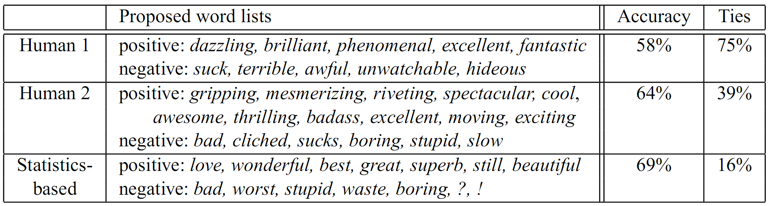
Challenges (II)
“This film should be brilliant. It sounds like a great plot, the actors are first grade, and the supporting cast is good as well, and Stallone is attempting to deliver a good performance. However, it can’t hold up” Opinion reversal
“I bought an iPhone a few days ago. It was such a nice phone. The touch screen was really cool. The voice quality was clear too. Although the battery life was not long, that is ok for me. However, my mother was mad with me… ” Topic drift
Lastly, in contrast to IR which is typically based on keywords, opinions are NOT easily conveyed by keywords.
e.g. “unpredictable plot” vs. “unpredictable steering”
Example from [5]:

